Slide 1




Hyderabad
Slices – 3W’s
Hema sai charan K
Android Freelancer
@hemandroid

Slide 2
Slices..

Slide 3
Why does it matter?
Architecture

Slide 4

3-W’s..
What?
Where?
Slices
Why?

Slide 5

What..
“UI template”
“Google Search and Google Assistant”
“Jetpack supports all the way back to Android 4.4 (API 19)”
“Reaching approx. 95% of Android users”

Slide 6

Hyderabad
How to build the slices..?

Slide 7

Prerequisites..
Android Studio 3.2
Download and install the Slice Viewer APK
Add the below library dependencies
dependencies {
implementation 'androidx.slice:slice-core:1.0.0' implementation 'androidx.slice:slice-view:1.0.0' implementation 'androidx.slice:slice-builders:1.0.0'
}
Hyderabad

Slide 8
Hyderabad
Where..

Slide 9
Hyderabad
Slices Examples..
Hotel rooms at your desired location
Dining options at nearby location
Listen to your favorite music from Radio
Fetching the ride details to desired location

Slide 10
Hyderabad
Architecture..
Slice Presenter
(i.e. Android Search)
URI
Slice Provider
Default Case
onBindSlice()
Slice
Slice Presenter
(i.e. Android Search)
notifyChange()
Slice Provider
ON Data change
URI
onBindSlice()
Slice
Host App: Google Assistant, Search
Your App

Slide 11
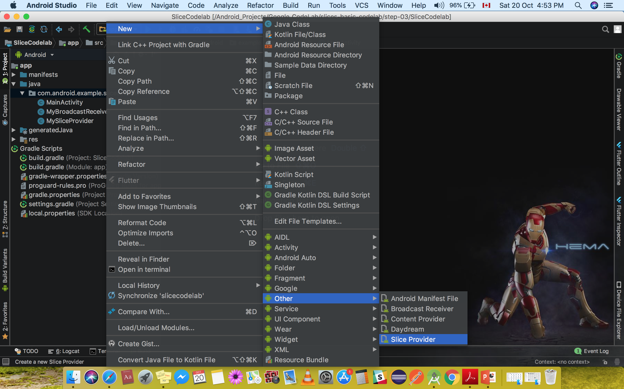
Hyderabad
Slice Provider..
<!-- To provide slices you must define a slice provider --> <provider android:authorities="com.android.example.slicecodelab" android:name=".MySliceProvider" android:exported="true"> <intent-filter> <action android:name="android.intent.action.VIEW"/> <category android:name="android.app.slice.category.SLICE"/> </intent-filter> </provider> <receiver android:name=".MyBroadcastReceiver"/>

Slide 12
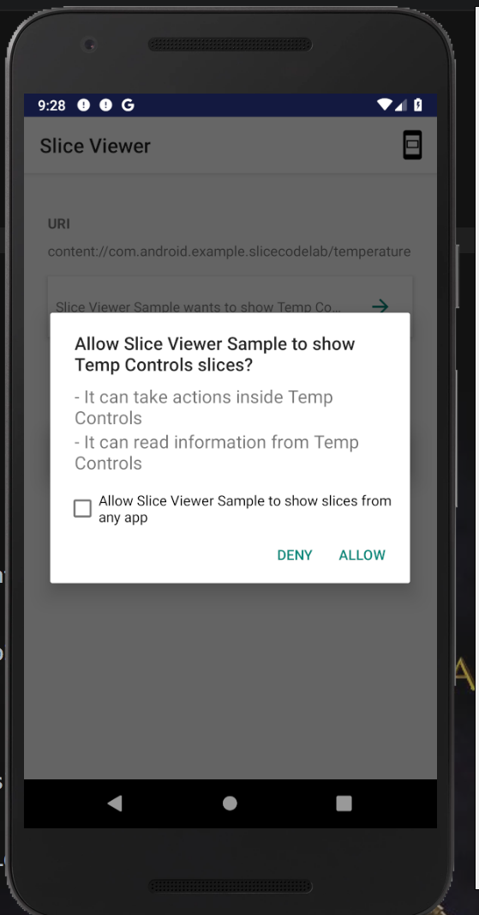
Permissions..
URI permissions:
(Indexable.sliceUri)
- or -
sliceManager.grantSlicePermission
sliceManager.revokeSlicePermission
Pie:
SliceProvider.onCreatePermissionRequest
Hyderabad

Slide 13
fun createSliceWithHeader(sliceUri: Uri) = list(context, sliceUri, ListBuilder.INFINITY) { setAccentColor(0xff0F9D) // Specify color for tinting icons header { title = "Get a ride" subtitle = "Ride in 4 min" summary = "Work in 1 hour 45 min | Home in 12 min" } row { title = "Home" subtitle = "12 miles | 12 min | $9.00" addEndItem( IconCompat.createWithResource(context, R.drawable.ic_home), ListBuilder.ICON_IMAGE ) } }
Slice Templates..
Slices are constructed by using a ListBuilder.
ListBuilder allows you to add different types of rows that are displayed in List.
You can combine multiple row types.
Ex: Header row along with a Grid row contains three cells

Slide 14
Slice Action
val intent = PendingIntent.getActivity(context, 0, Intent(context, MainActivity::class.java),0)
val image = IconCompat.createWithResource(context,
R.drawable.ic_home)
val homeAction1 = SliceAction.create(intent, image, ListBuilder.ICON_IMAGE, “Go to Home Screen")
or // SliceAction.createDeepLink(…)
val toggleIntent = PendingIntent.getBroadcast(context, 0,
Intent(context, MyReceiver::class.java), 0)
val toggleAction = SliceAction.createToggle(toggleIntent,
"Toggle Wi-Fi", isConnected /* isChecked */)
Slice Action can consists of a title, icon and a pendingIntent
Class supports Action, tappable icons, custom toggle icons and default toggles.
Image mode: How the image is presented for the Action
ICON_IMAGE: tiny size and tintable
SMALL_IMAGE: small size and non-tintable
LARGE_IMAGE: largest size and non-tintable

Slide 15
Display Modes..
Large: Whole slice will be displayed
Shortcut: Whole slice will be displayed
Small: Whole slice will be displayed
Hyderabad

Slide 16
Types of Builders..
Header Builder
Row Builder
GridRow Builder
Range Builder
Disabled Scrolling
Hyderabad

Slide 17
fun createSliceWithHeader(sliceUri: Uri) = list(context, sliceUri, ListBuilder.INFINITY) { setAccentColor(0xff0F9D) // Specify color for tinting icons header { title = "Get a ride" subtitle = "Ride in 4 min" summary = "Work in 1 hour 45 min | Home in 12 min" }
}
Header Builder..
Title, subtitle, summary subtitle, Primary Action
A header provides some additional functionality compared to a ListBuilder.RowBuilder
Slice headers can also display SliceActions.

Slide 18
gridRow { cell { addImage(image1, LARGE_IMAGE) addTitleText("Top Restaurant") addText("0.3 mil") contentIntent = intent1 } cell { addImage(image2, LARGE_IMAGE) addTitleText("Fast and Casual") addText("0.5 mil") contentIntent = intent2 } cell { addImage(image3, LARGE_IMAGE) addTitleText("Casual Diner") addText("0.9 mi") contentIntent = intent3 }
}
GridRow Builder..
ICON_IMAGE: tiny size and tintable
SMALL_IMAGE: small size and non-tintable
LARGE_IMAGE: largest size and non-tintable
A grid cell is constructed by using Cell Builder.
It can support up to two lines of text and one image. != Empty

Slide 19
Slice Viewer..
A tool that allow you to preview and test your slices
See https://github.com/googlesamples/android-SliceViewer/releases
Usage Example:
Install the sliceviewer APK: adb install slice-viewer.apk
Run your App: adb install –t –r <yourapp>.apk
Test and view your Slice by running your command: adb shell am start –a android.intent.action.View –d slice-<slice URI>

Slide 20
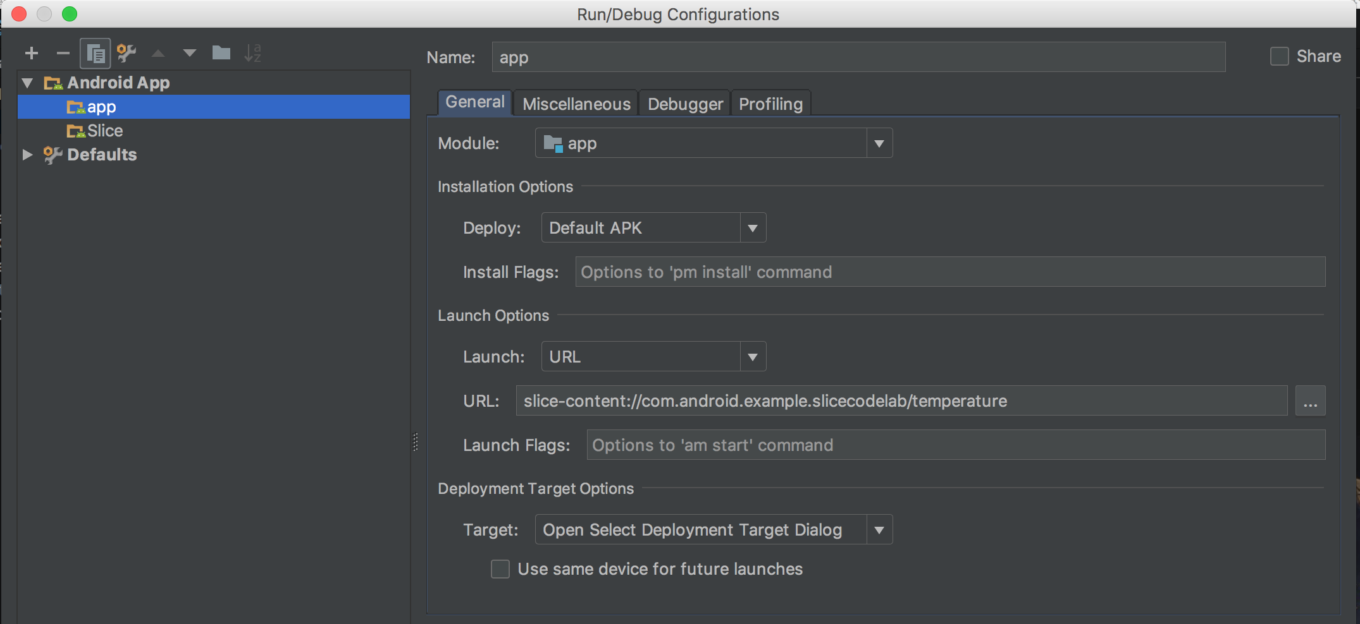
Edit Configuration..

Slide 21
Why..
- Nearly 1 in 4 people disavow the mobile app after one use

Slide 23
Hyderabad
Thank you!
Hema sai charan K
Android Freelancer
linkedin.com/hemandroid
github.com/hemandroid

